Slide 1




Ting Gao
Cancan huang
Jacqueline
Tan
Yushi
Yao
Notes:
大侠素材铺 淘宝店：https://dxpu.taobao.com/

Slide 2
Introduction & Demo
Testing & Goals
Future work &
Contributions &
Final Thought
Design & Implementation

Slide 3
Introduction & Demo

Slide 4
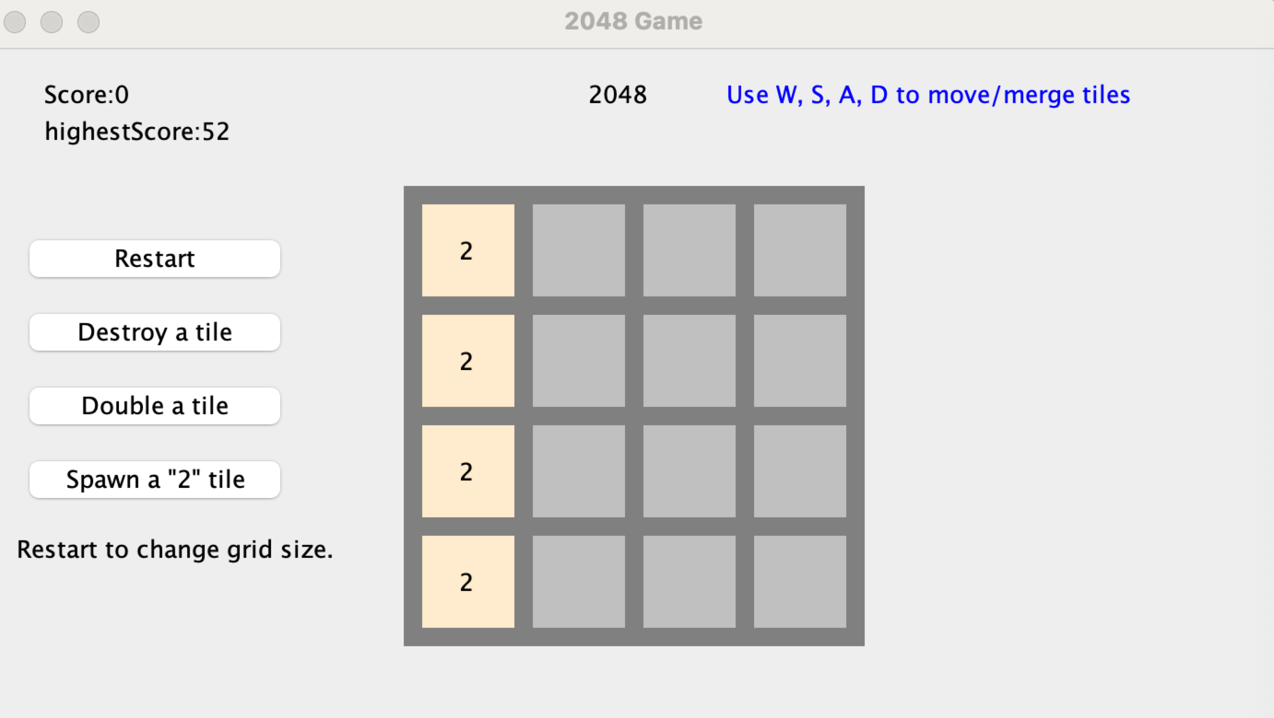
Introduction
Notes:
You need to control all the cubes to move in the same direction, two identical numbers collide and merge to form their sum. After each operation, a random 2 or 4 will be generated, and finally a "2048" block is considered victory.

Slide 5
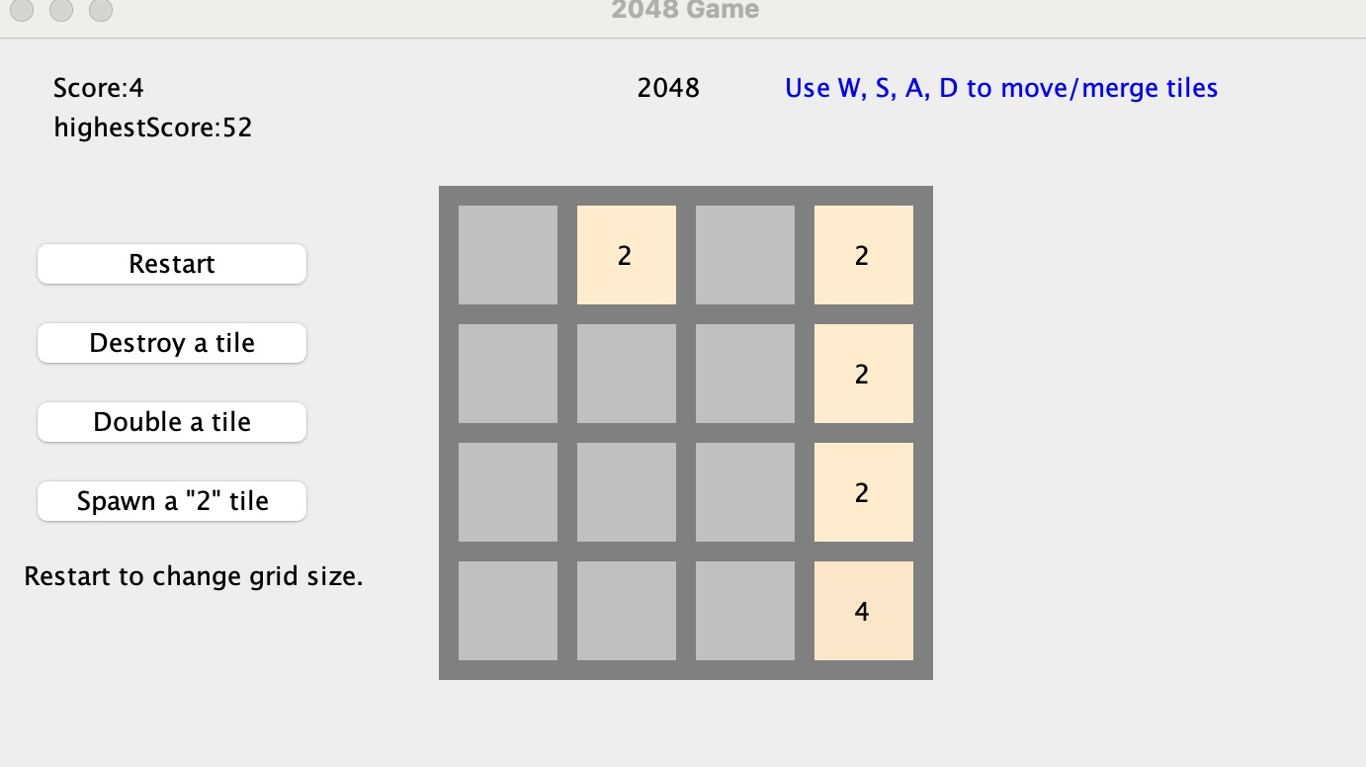
Demo
01About move, merge and score
Score records the newly points.
The highest score is still recorded as the previous highest score.
new number
Notes:
Score records the newly synthesized 4 points.
The highest score is still recorded as the previous highest score.
This step uses D to move one step to the right, adding the two identical twos to form a new number four.

Slide 6
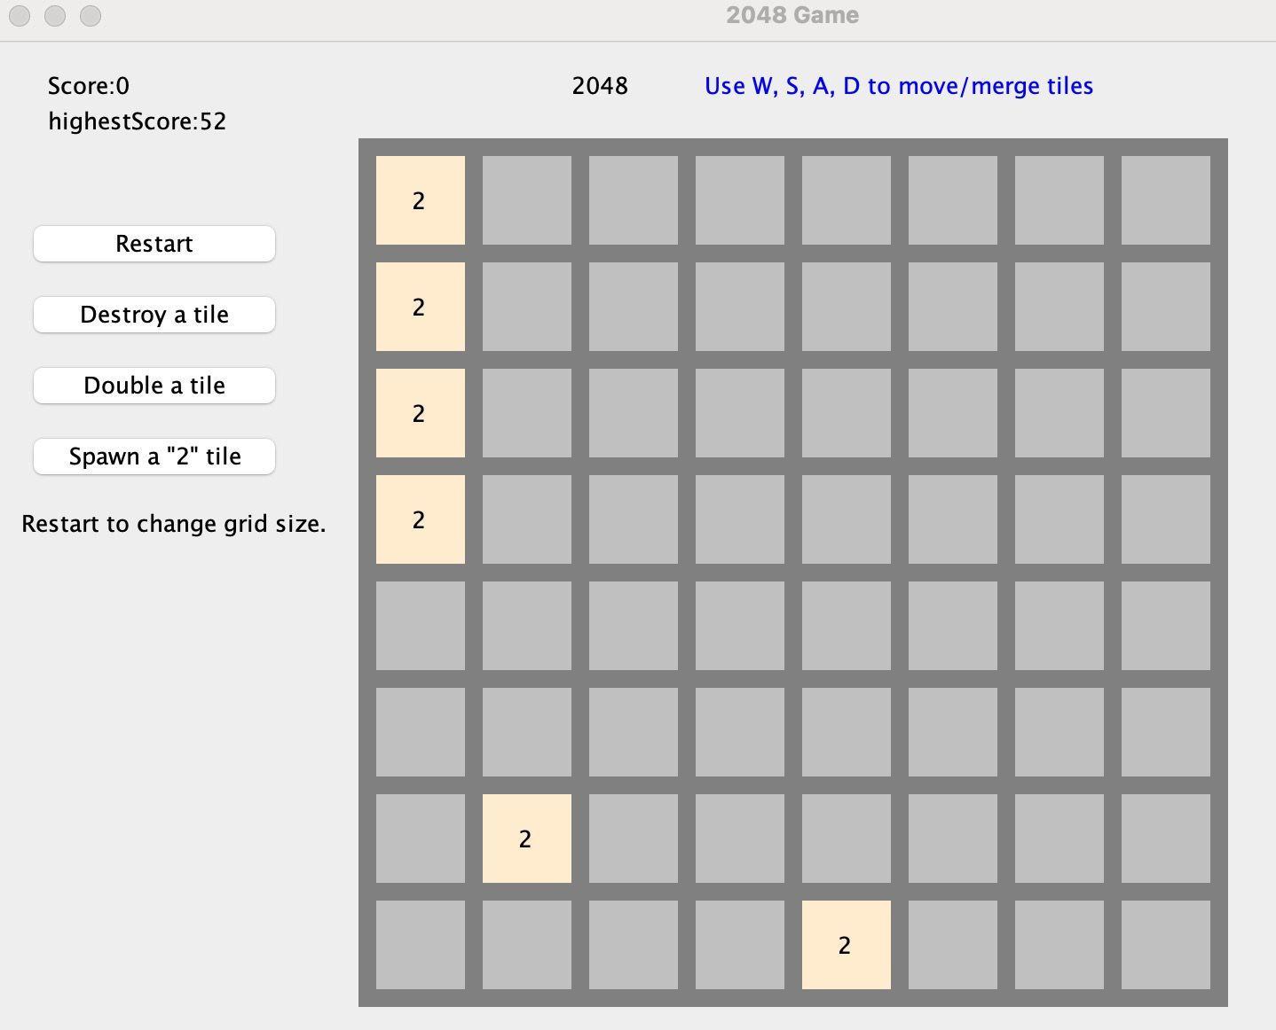
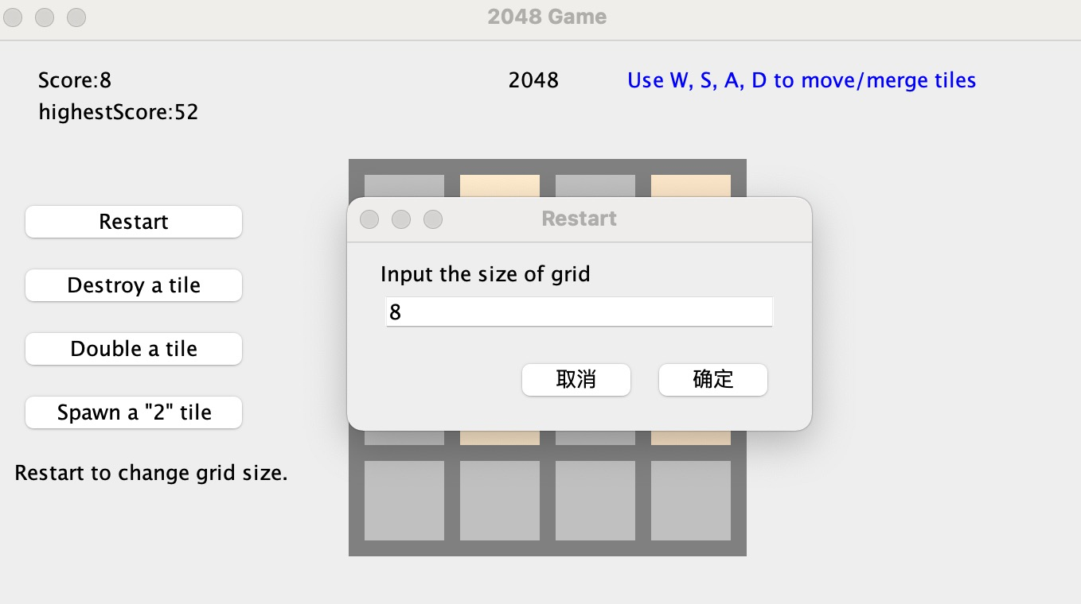
Demo
02About Function Keys

Slide 7
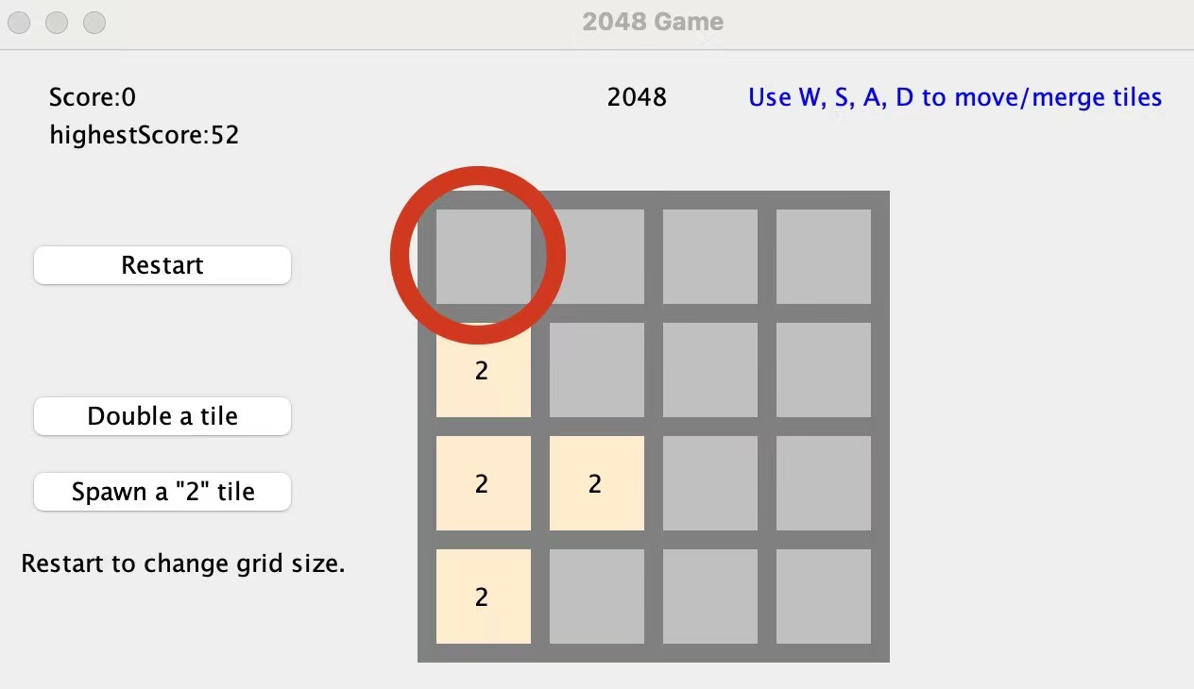
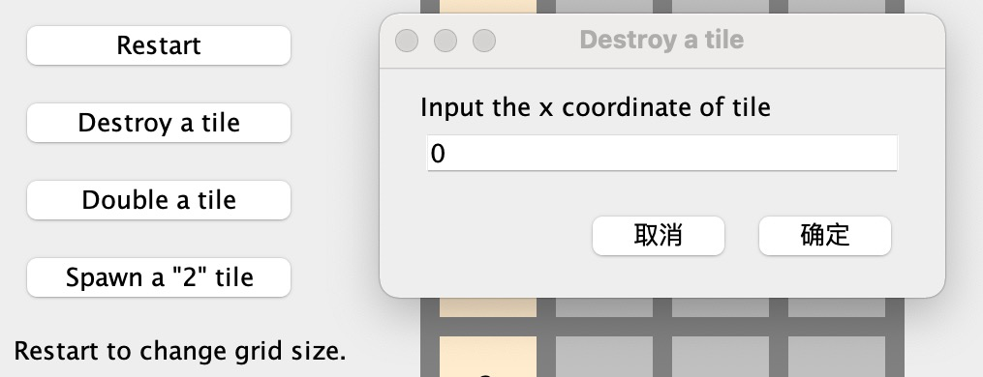
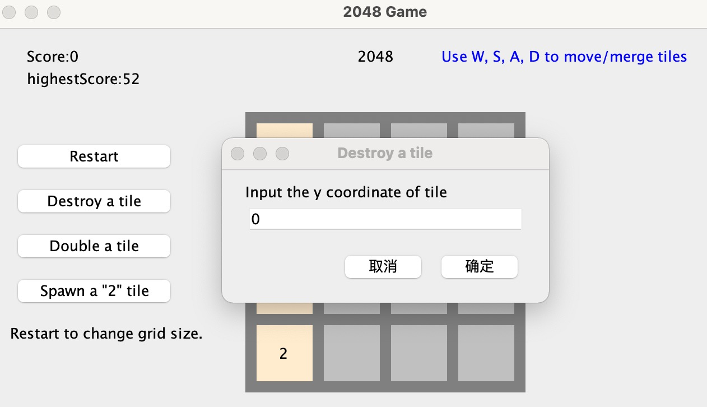
Demo
02About Function Keys

Slide 8
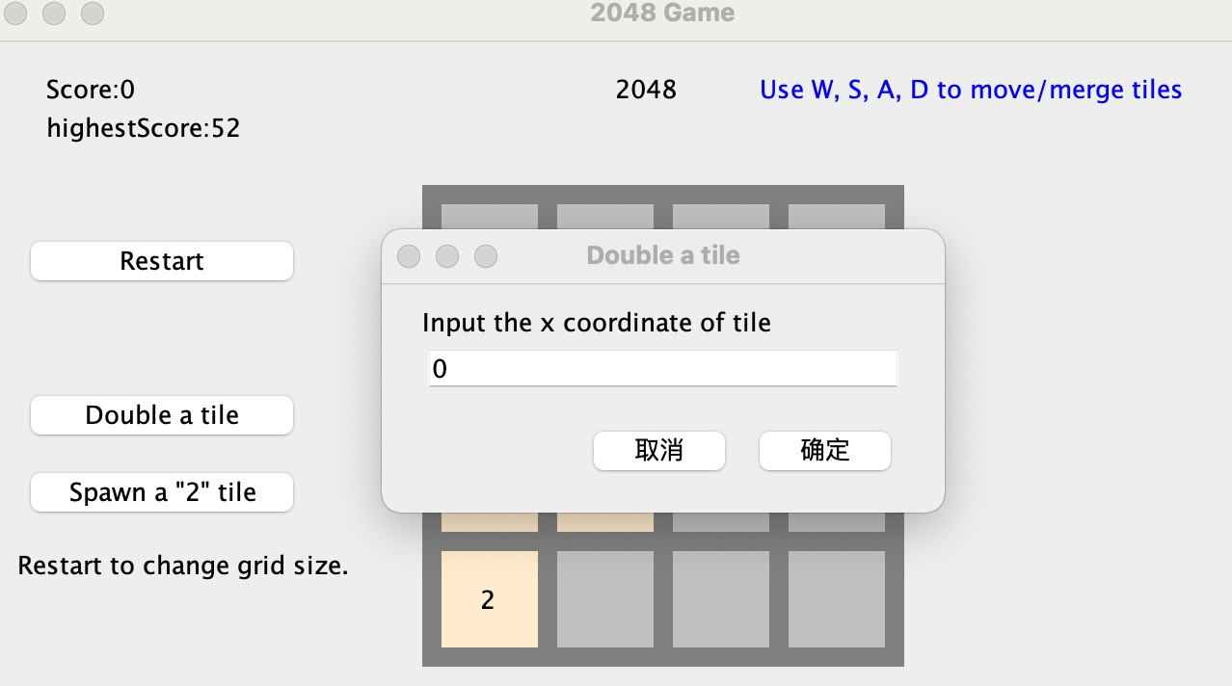
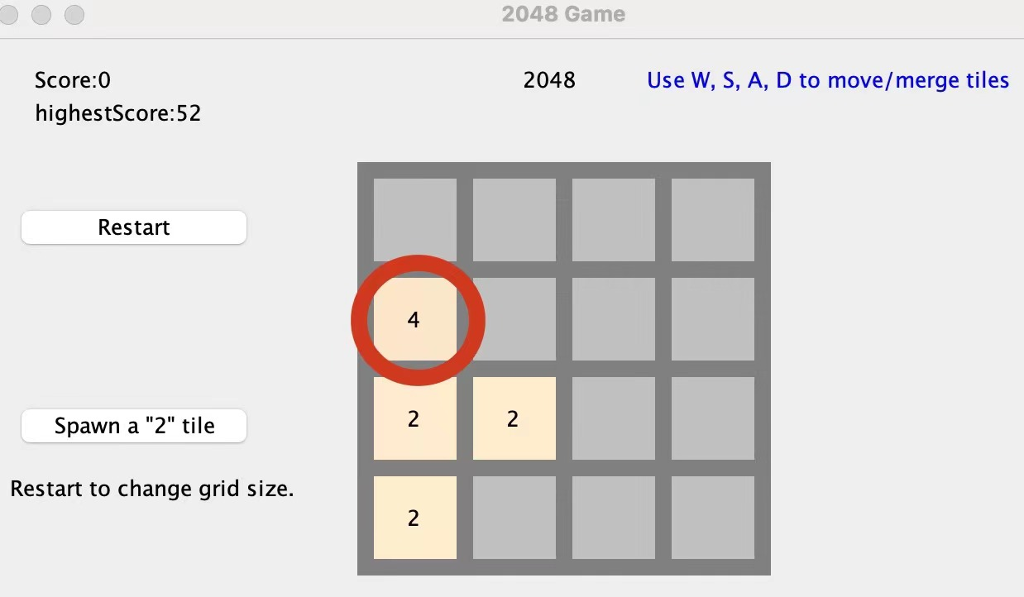
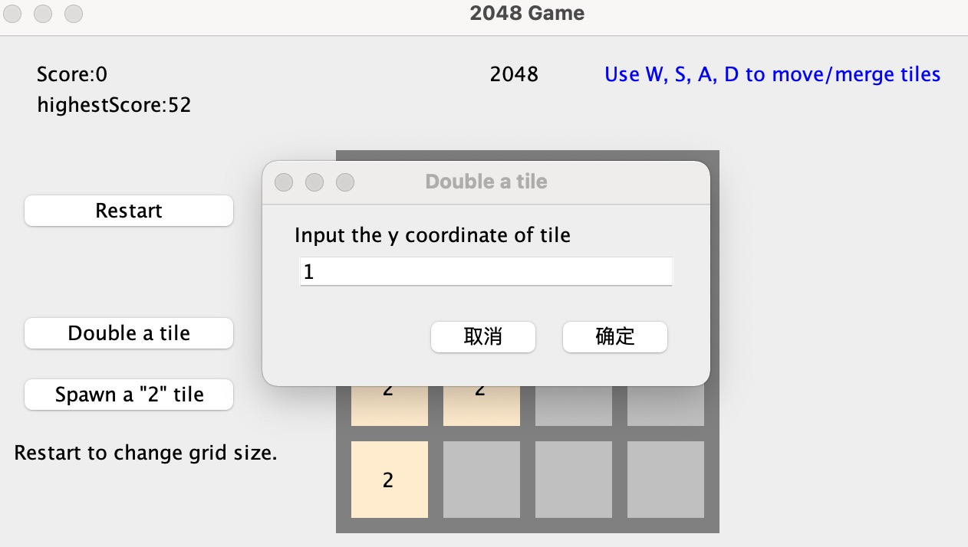
Demo
02About Function Keys

Slide 9
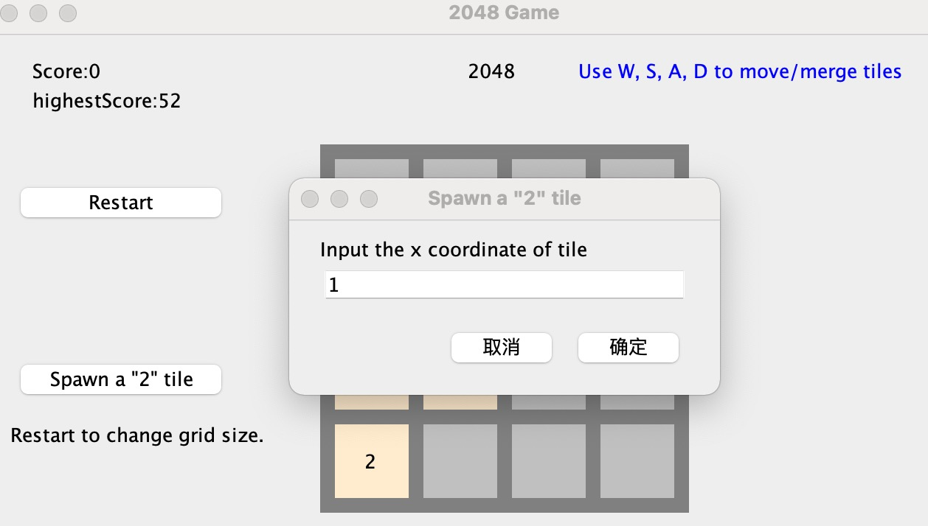
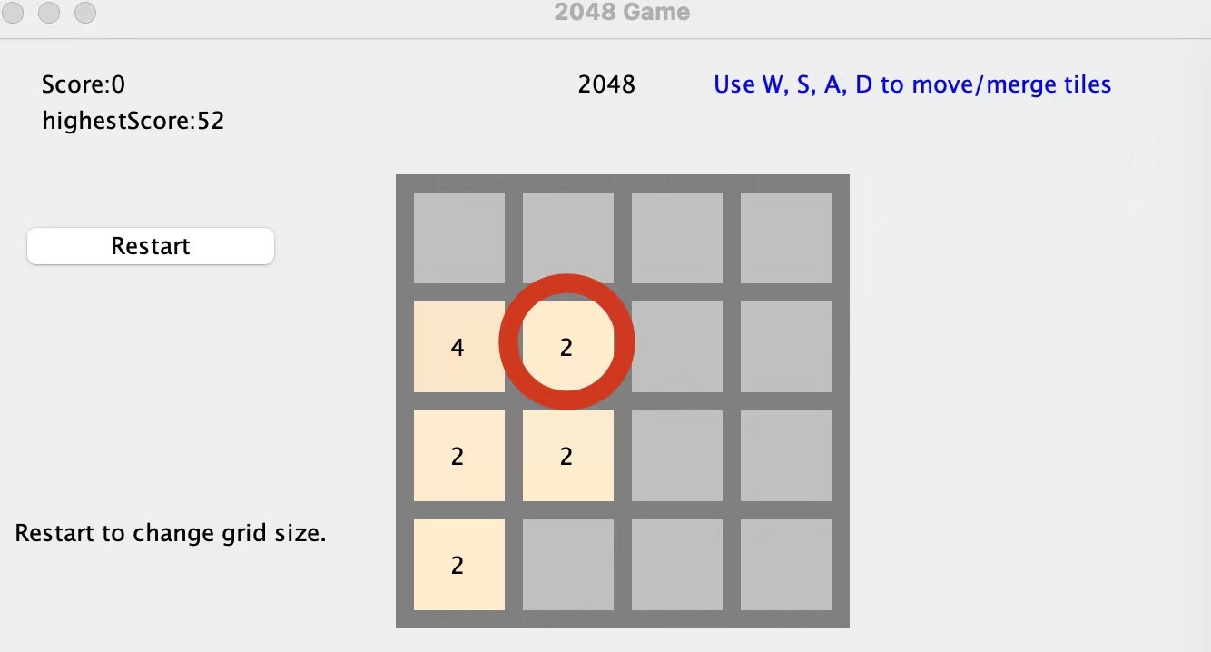
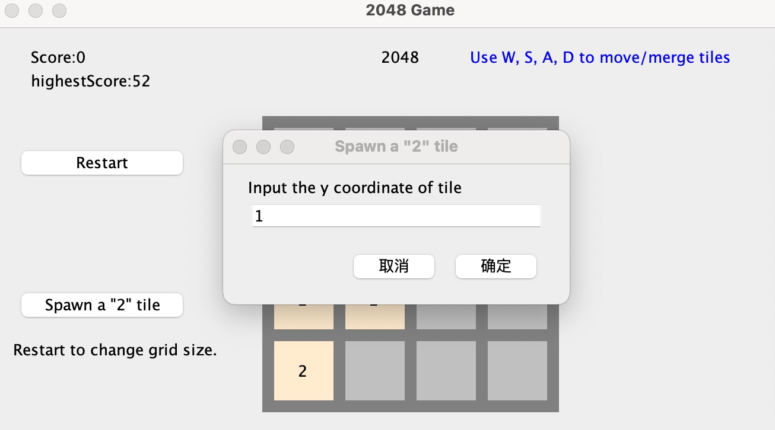
Demo
02About Function Keys

Slide 10
Design & Implementation

Slide 11
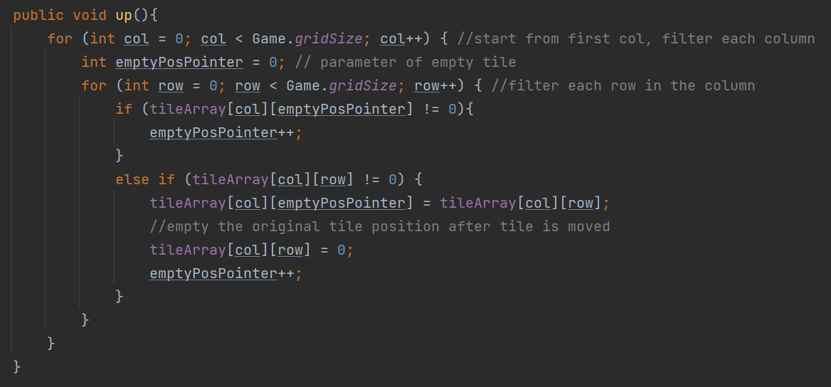
Design
Time Complexity: O(N^2)
separate method for each movement

Slide 12
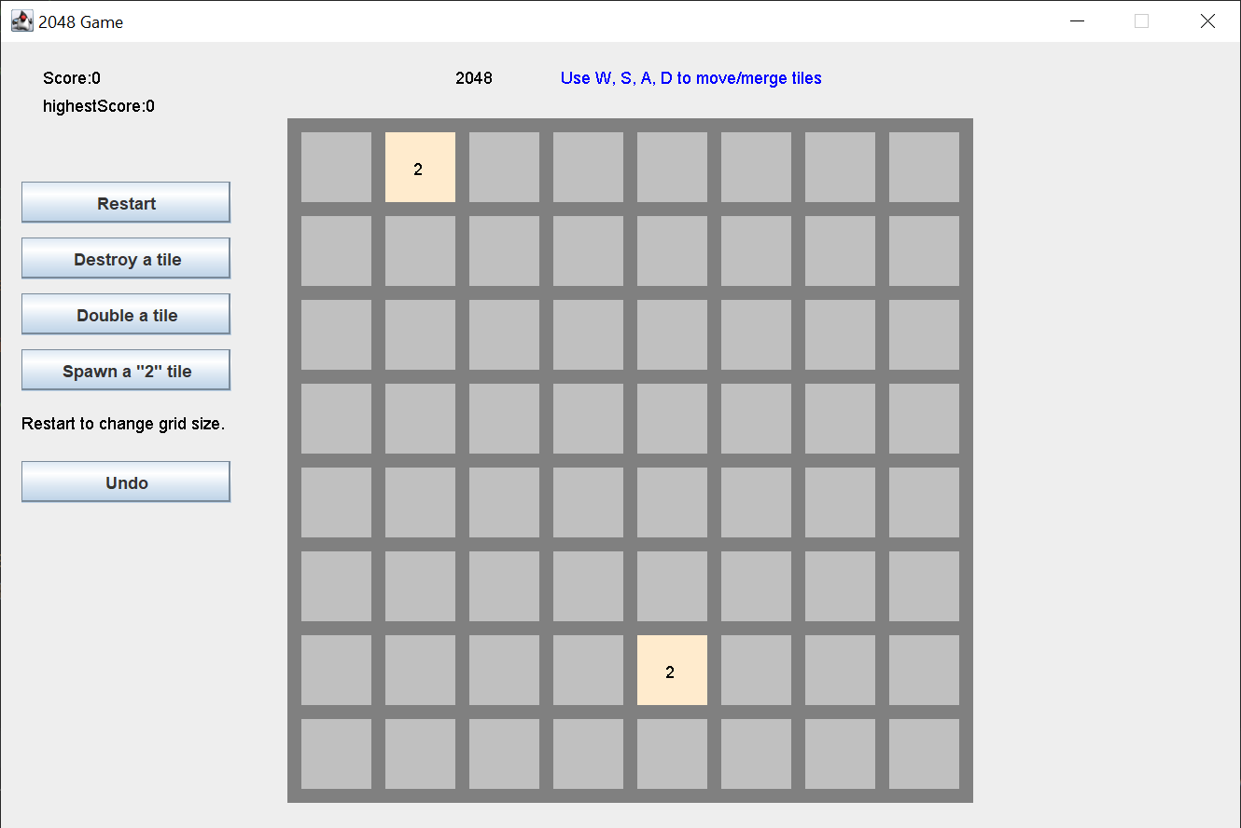
Design
Alterable grid size
More “2” tiles spawned each round
Added single-use abilities

Slide 13
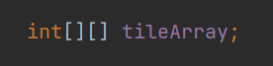
Implementation
Most similar and intuitive
x coordinate
y coordinate

Slide 14
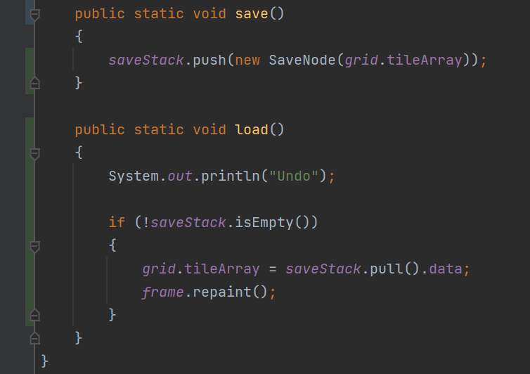
Implementation
More efficient and easier than recording each change of tile
Specially implemented,
lower space complexity

Slide 15
Testing & Goals

Slide 16
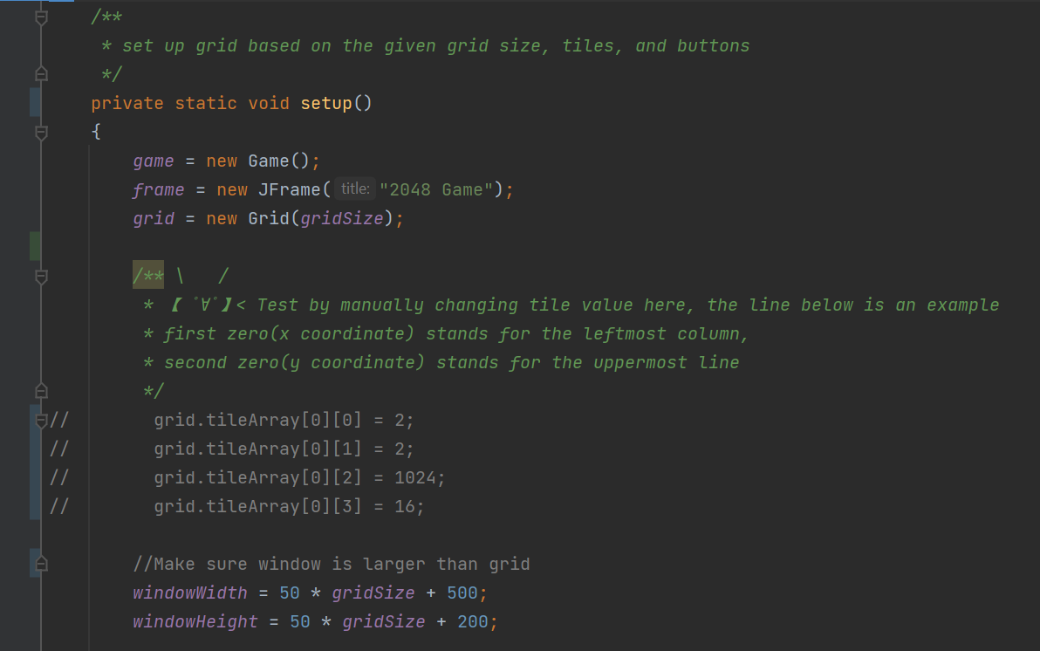
Testing
Fixed multiple bugs after testing
No more bugs so far
Notes:
We have tested our project many times by playing the game, creating/modifying/removing highest score file, inputting invalid number after being prompted to choose the size of new grid or position of tile to be destroyed, doubled, or spawned.

Slide 17
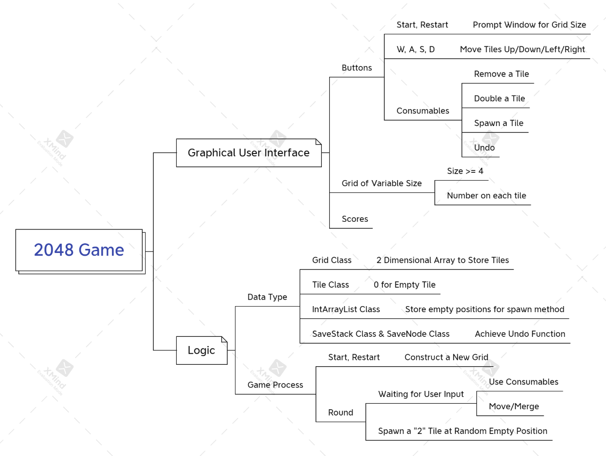
Goals
Not much change
Added undo ability, IntArrayList, SaveStack and SaveNode
Notes:
We have tested our project many times by playing the game, creating/modifying/removing highest score file, inputting invalid number after being prompted to choose the size of new grid or position of tile to be destroyed, doubled, or spawned.

Slide 18
Future work & Contributions & Final Thought

Slide 19
Contribution
Ting Gao
Making mind map, framework of codes, GUI, buttons method, keyPressed method, spawn method, implementing SaveStack and SaveNode, and writing check-ins.
Cancan Huang
Writing buttons methods, implementing score and highest score function, making framework of presentation slides
Jacqueline Tan
Writing core logics, move, of the 2048 game, including up, down, left, and right method
Yushi Yao
Writing merge methods, including up, down, left, right, designing different colors for different values of tile, implementing intArrayList, and editing videos

Slide 20
Future work
Test by general public
Add sound effect
More unique functions
Better GUI
Add music

Slide 21
Final Thought
Ting Gao
Not plain sailing but interesting and valuable
Cancan Huang
Although details took some time. On the whole, the project went well.
Jacqueline Tan
The game runs smoothly, overall successful project
Yushi Yao
Enjoyable group project, everyone sticking to the plan

Slide 22
xxx

